Slide 1
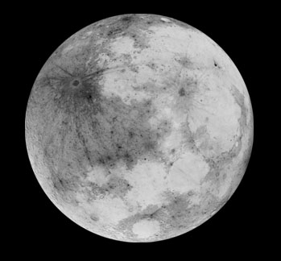
Night Prayer
Lord, it is night.
The night is for stillness. Let us be still in the presence of God.
It is night after a long day. What has been done has been done;
what has not been done has not been done; let it be.
The night is dark. Let our fears of the darkness of the world
and of our own lives rest in you.
The night is quiet. Let the quietness of your peace enfold us,
all dear to us, and all who have no peace.
The night heralds the dawn. Let us look expectantly to a new day,
new joys, new possibilities.
In your name we pray.
Amen.
— A New Zealand Prayer Book -
He Karakia Mihinare o Aotearoa

Slide 3
Leader God whispers to the heart, “Be still; I am with you.”
People God whispers to the heart, “Be still; I am with you.”
Leader God is our refuge and our strength,
a present help in times of trouble.
Therefore we will not fear,
though the earth be moved and shaken.
People God whispers to the heart, “Be still; I am with you.”
Leader We will not fear
though the mountains be toppled into the sea, though the depths of the waters rage and foam.
People God whispers to the heart, “Be still; I am with you.”
Leader “Be still, and know that I am God.”
God is with us,
God has spoken,
and the earth shall melt away.
People God whispers to the heart, “Be still; I am with you.” ~ Psalm 46

Slide 4
Leader In the shadow of your wings I rejoice, alleluia.
People In the shadow of your wings I rejoice, alleluia.
Leader O God, my God at dawn I seek you,
For you my soul is thirsting,
My flesh is longing,
Like a dry and parched land longs for water.
People In the shadow of your wings I rejoice, alleluia.
Leader I have gazed on you in the holy place
To behold your power and your glory.
Better than life itself is your love.
My lips will sing your praise.
People In the shadow of your wings I rejoice, alleluia.
Leader I rejoice in the shadow of your wings.
To you my soul has held fast,
You have sustained me by your right hand.
People In the shadow of your wings I rejoice, alleluia. ~ Psalm 63

Slide 5
Leader Let justice roll down like waters, and righteousness like an ever-flowing stream.
People Let justice roll down like waters, and righteousness like an ever-flowing stream.
Leader Rise up, O healers, and open your hearts.
Let go of your indifference
and be present to tears, pain and anger.
May the God of love be felt in the care you offer.
People Let justice roll down like waters, and righteousness like an ever-flowing stream.
Leader Rise up, O peace-makers, and open your eyes
that you may see clearly the poverty and injustice
that must be addressed.
May the God of justice be known in your actions.
People Let justice roll down like waters, and righteousness like an ever-flowing stream.
Leader Rise up, O truth tellers, and lift your voices
to fearlessly call out the wrongs you see.
May the God of truth speak through your lips.
People Let justice roll down like waters, and righteousness like an ever-flowing stream.

Slide 6
Centering Prayer Guidelines
1. Choose a sacred word or a sacred breath as the symbol of your intention to consent to God’s presence and action within.
2. Sitting comfortably and with eyes closed, settle briefly and silently introduce the sacred word or the sacred breath as the symbol of your consent to God’s presence and action within.
3. When engaged with your thoughts, return ever-so-gently to the sacred word or breath.
4. At the end of the prayer period, remain in silence with eyes closed for a couple of minutes.

